Slide 1
UnityWrite_StorySphere Presentation on CMS - Blog App
Presented by: Preu Sharma
Roll No. : 2110991061
Group: G2

Slide 2
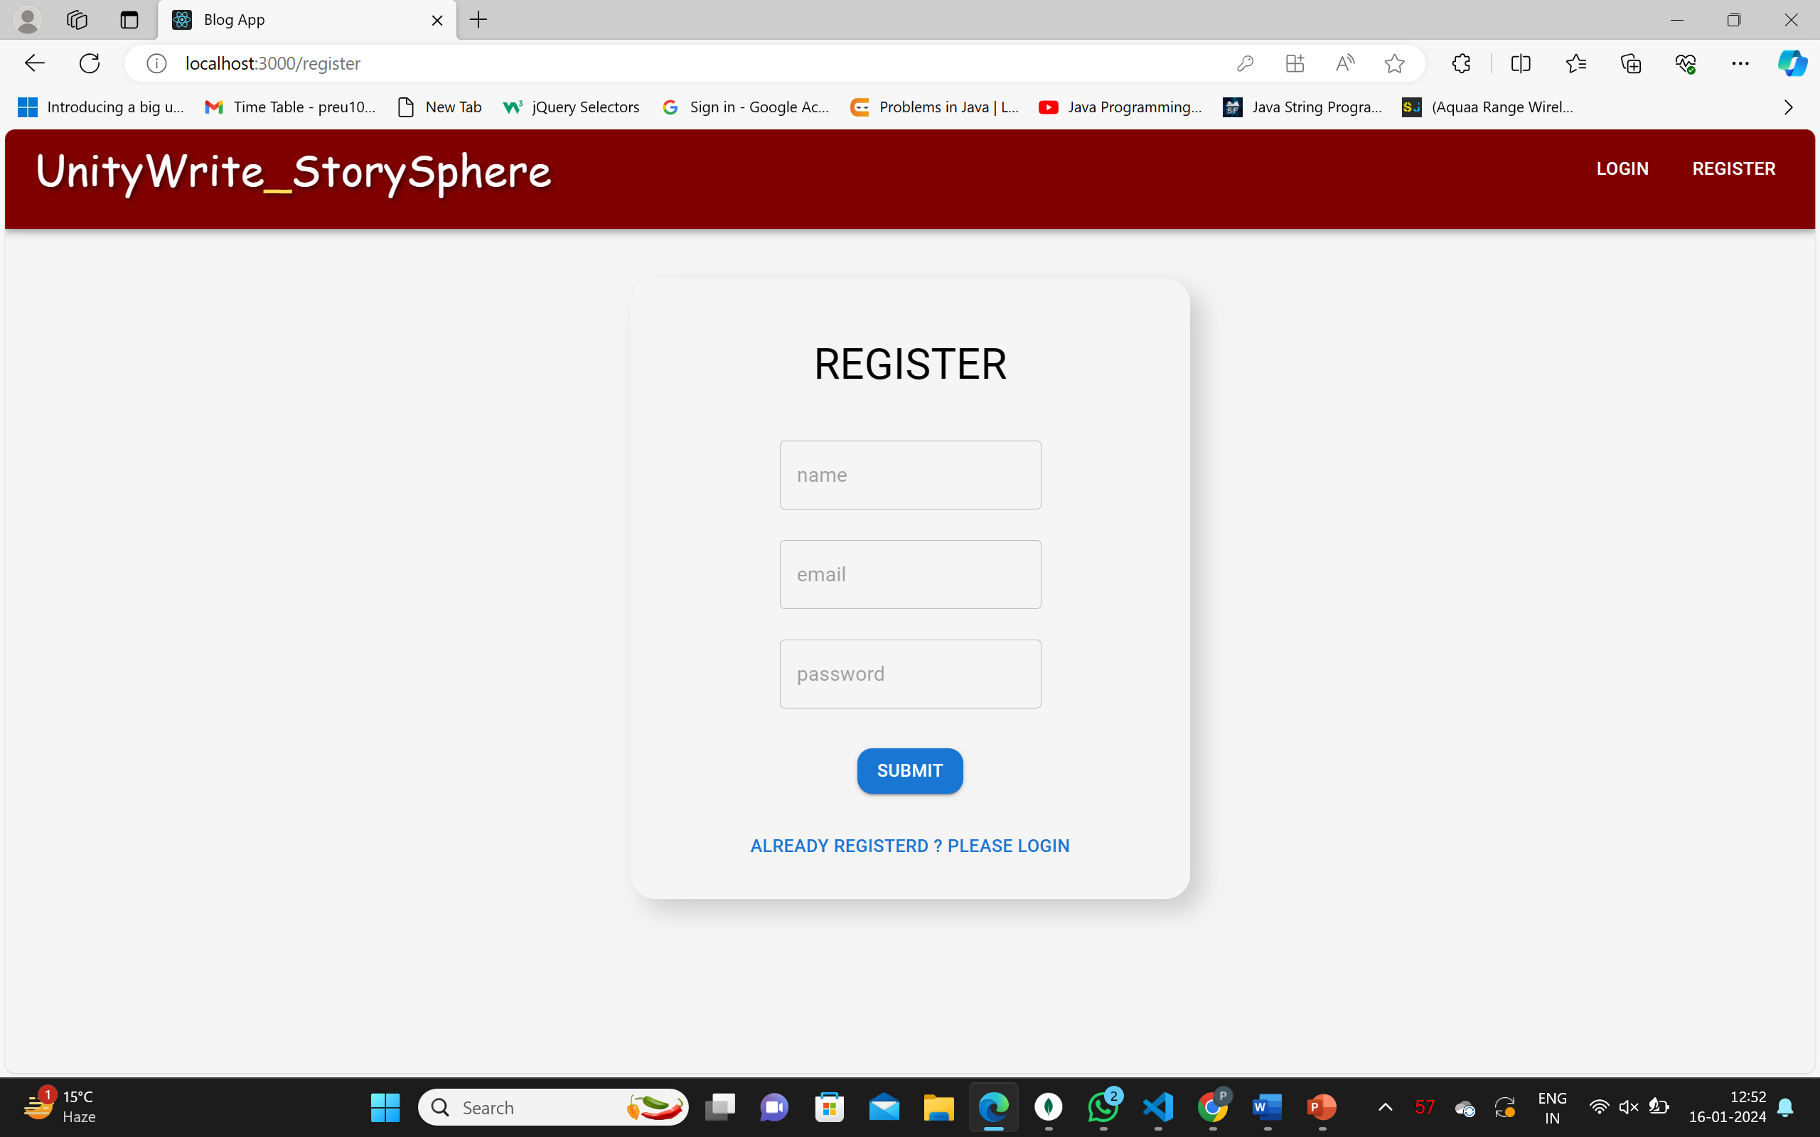
This is the Register Page : Allows users to register.

Slide 3
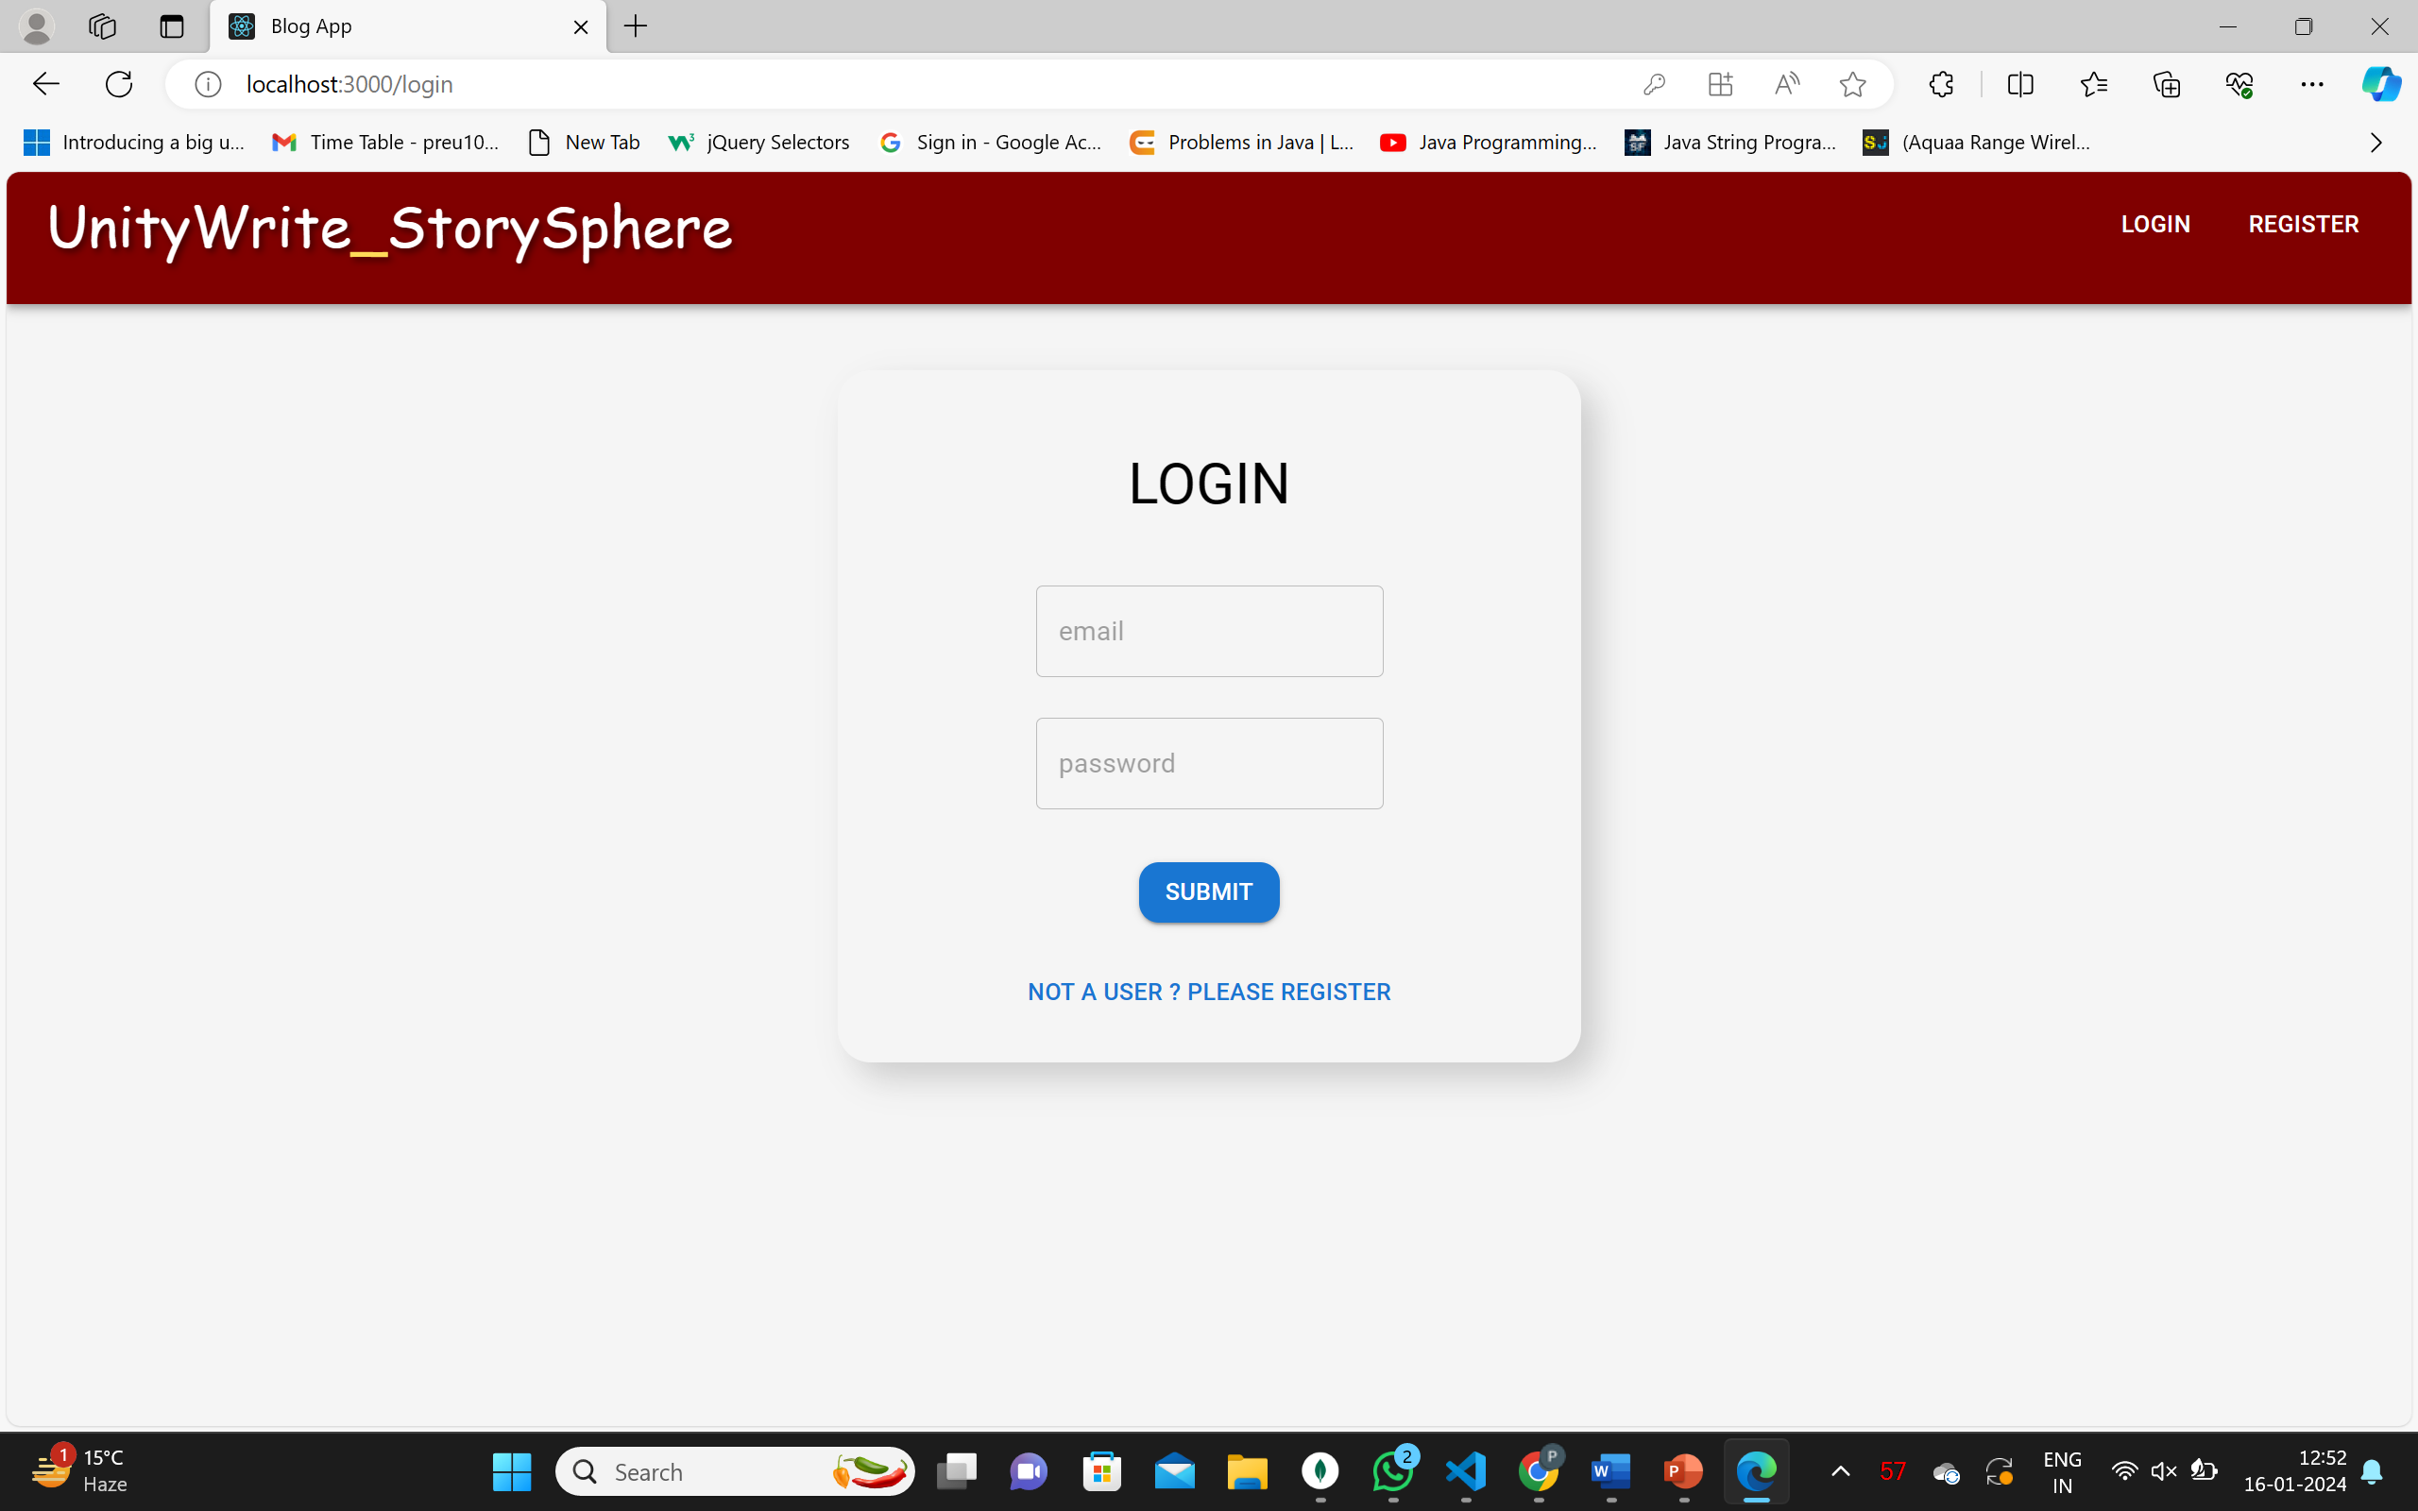
This is the Login Page : Provides a form for users to log in.

Slide 4
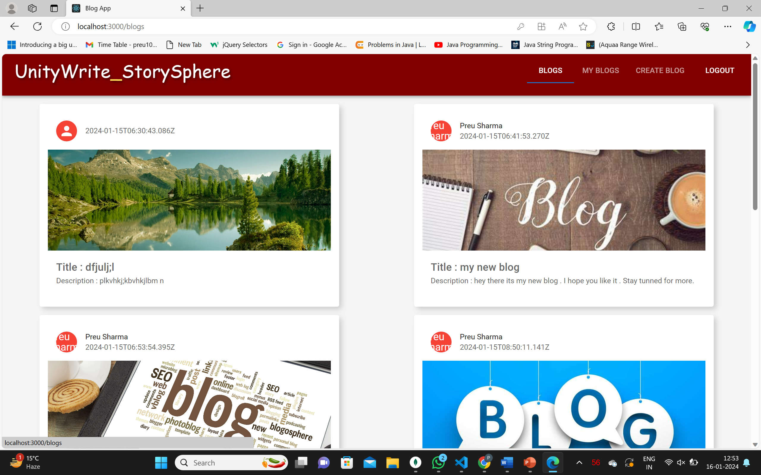
This the Blogs Page: Displays all blogs.

Slide 5
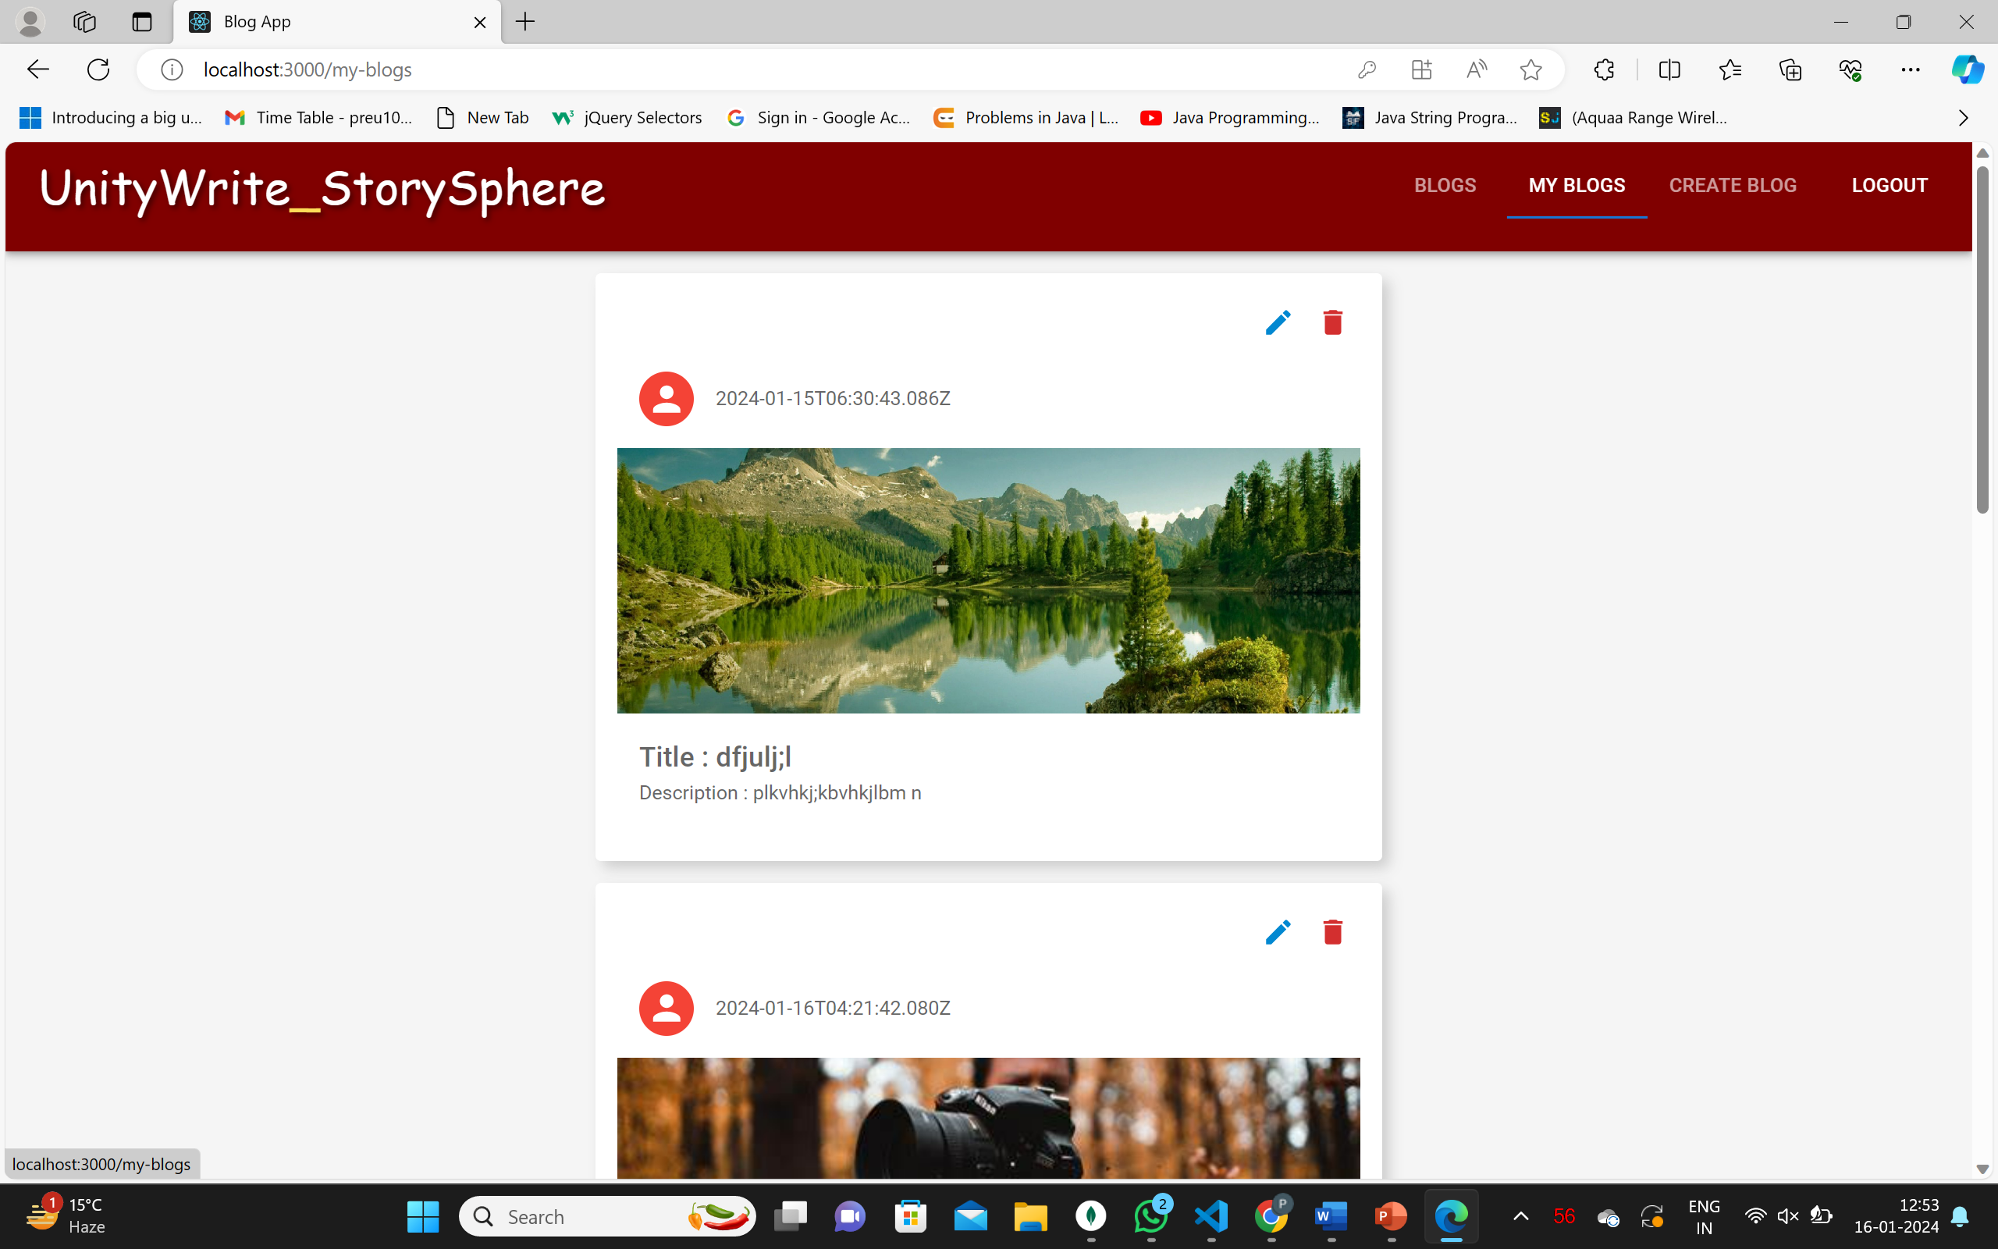
This is MyBlogs Page: Shows blogs created by the logged-in user.
The user can edit as well as delete its blog.

Slide 6
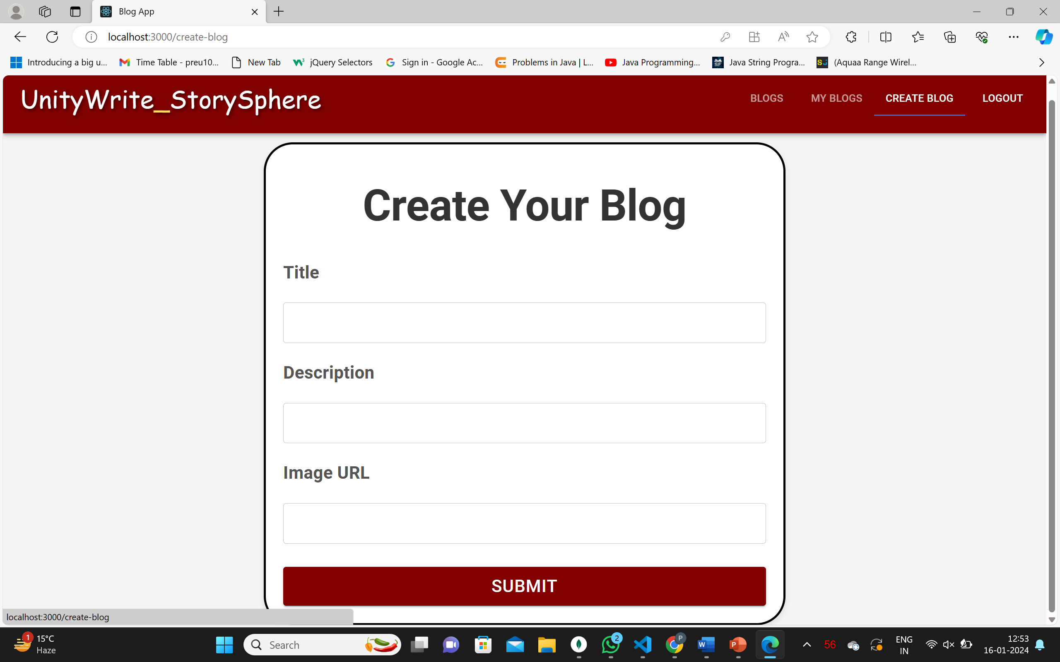
This is Create Blog Page: Form for creating a new blog.

Slide 7
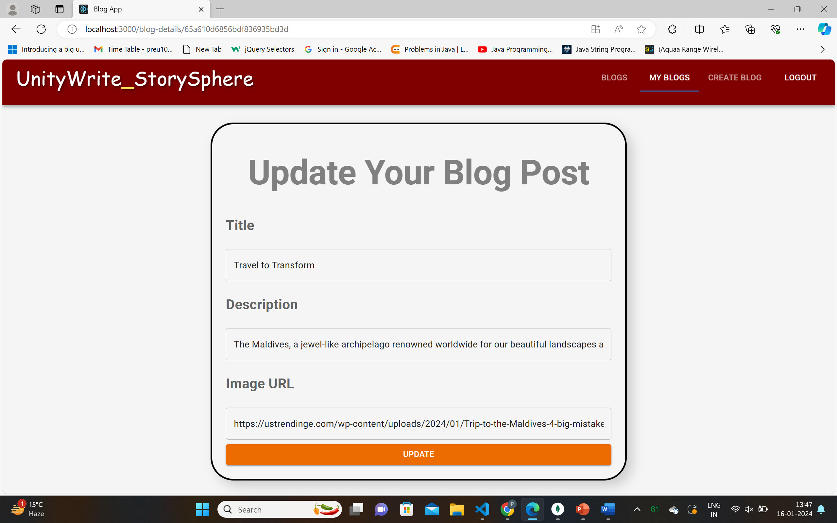
Here user can update his/her posted blog.

Slide 8
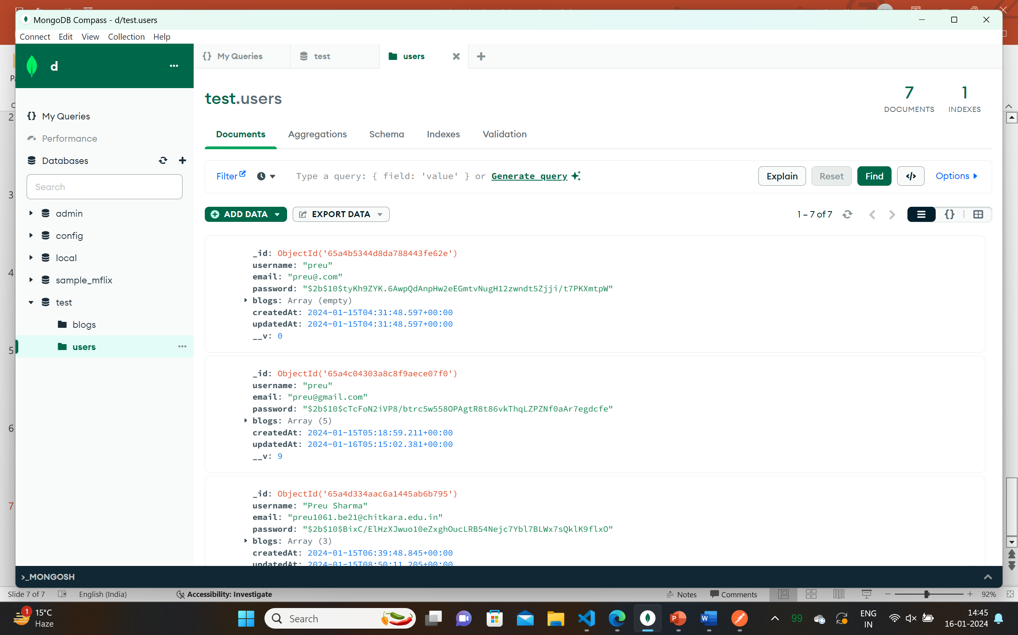
This is my MongoDB database connection , where I can get each and every detail of my CRUD operation used.

Slide 9
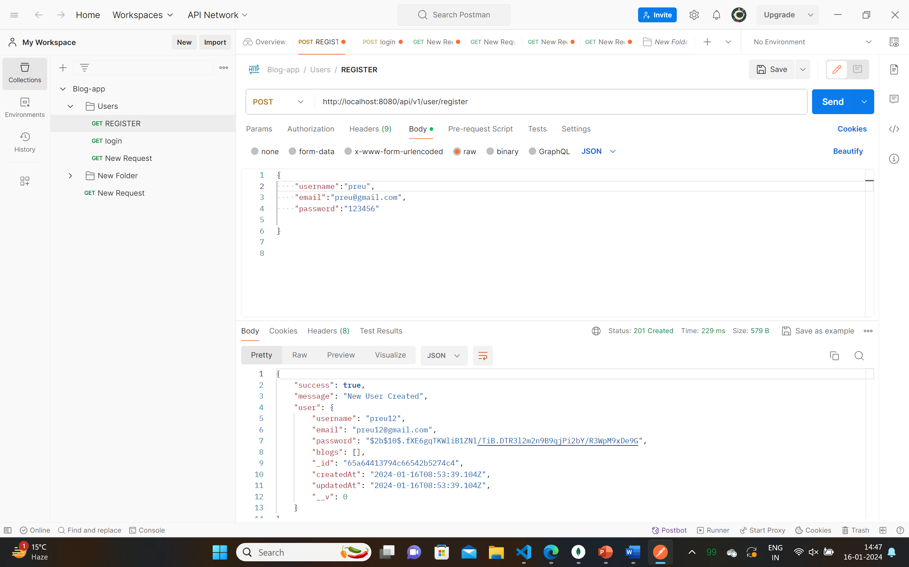
I have used Postman for confirming my current user status.

Slide 10
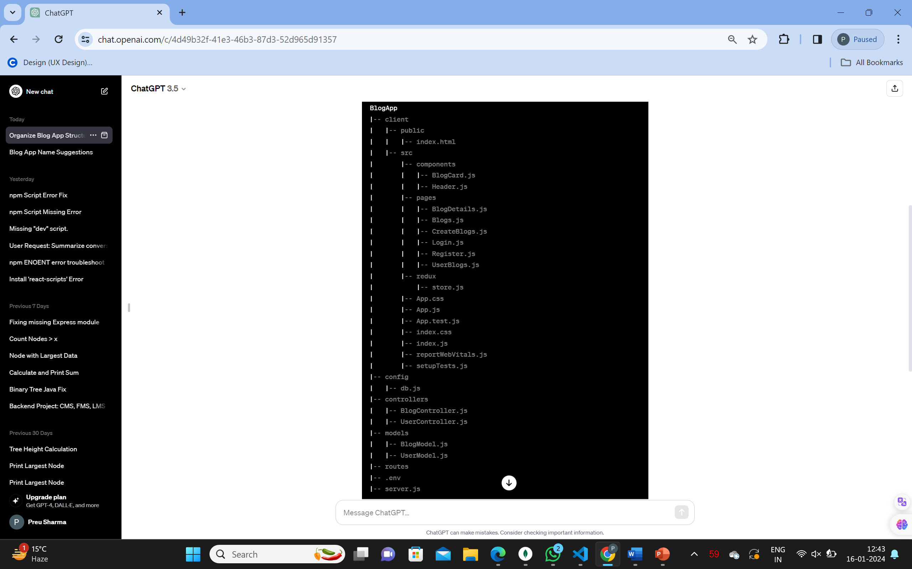
File Structure of My Blog App

